Slide 1
Ugly Boxes + Experimental Sensors
Jordan Fleming
Argonne National Laboratory | Department of Energy

Slide 2
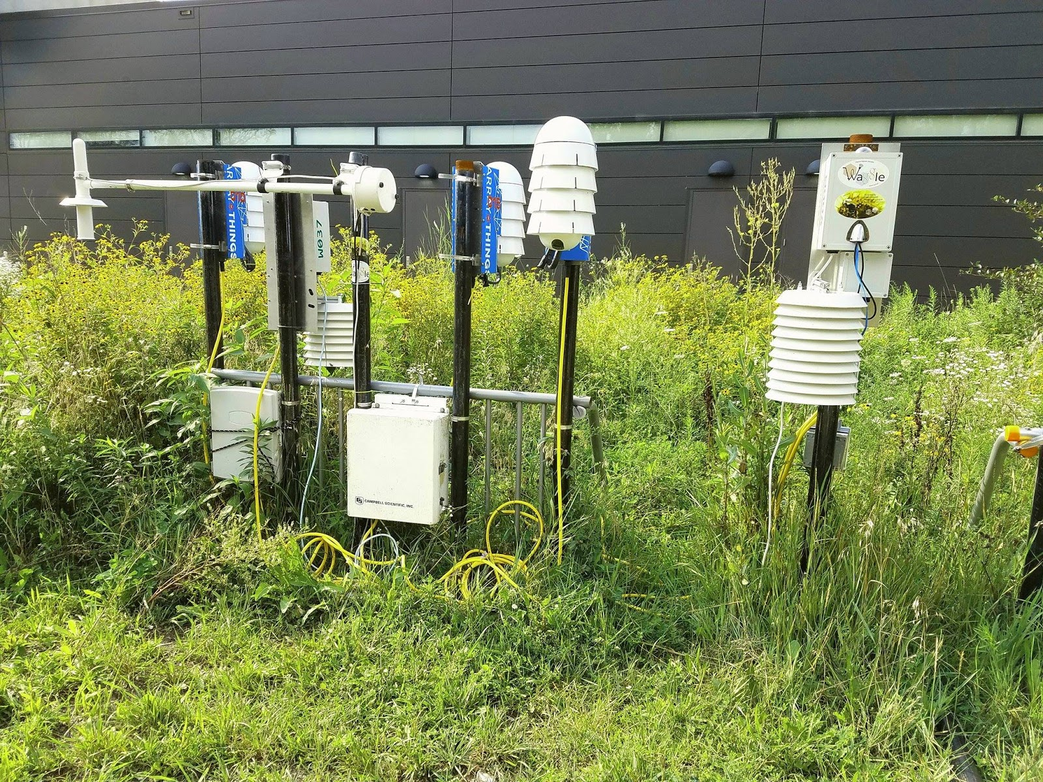
How can we extend the applicability of the Waggle platform to more use cases and environments, through novel sensors and embedded hardware modules?

Slide 3
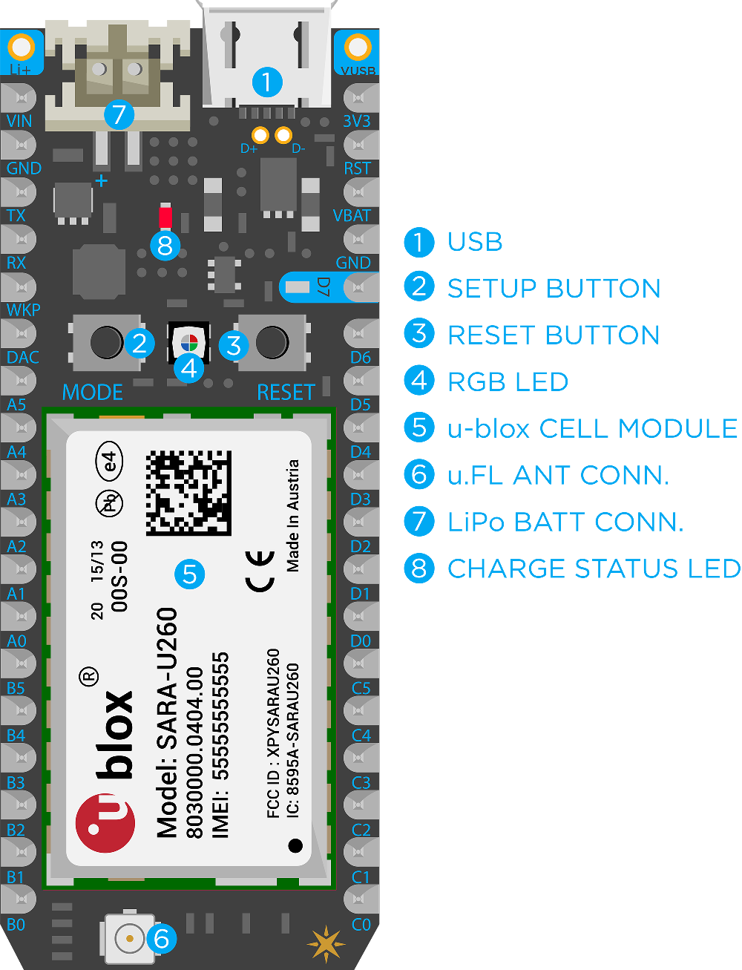
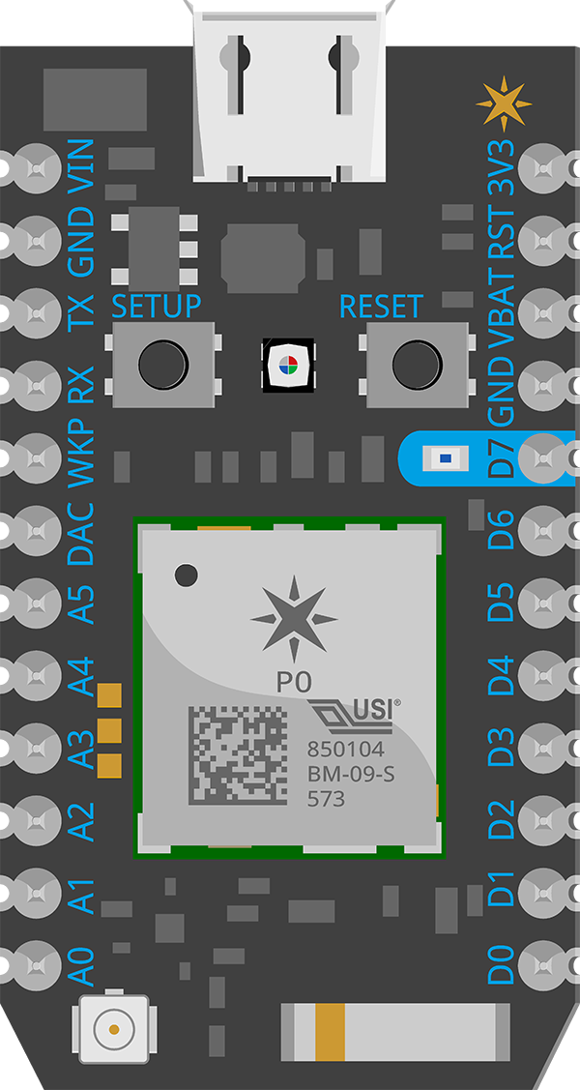
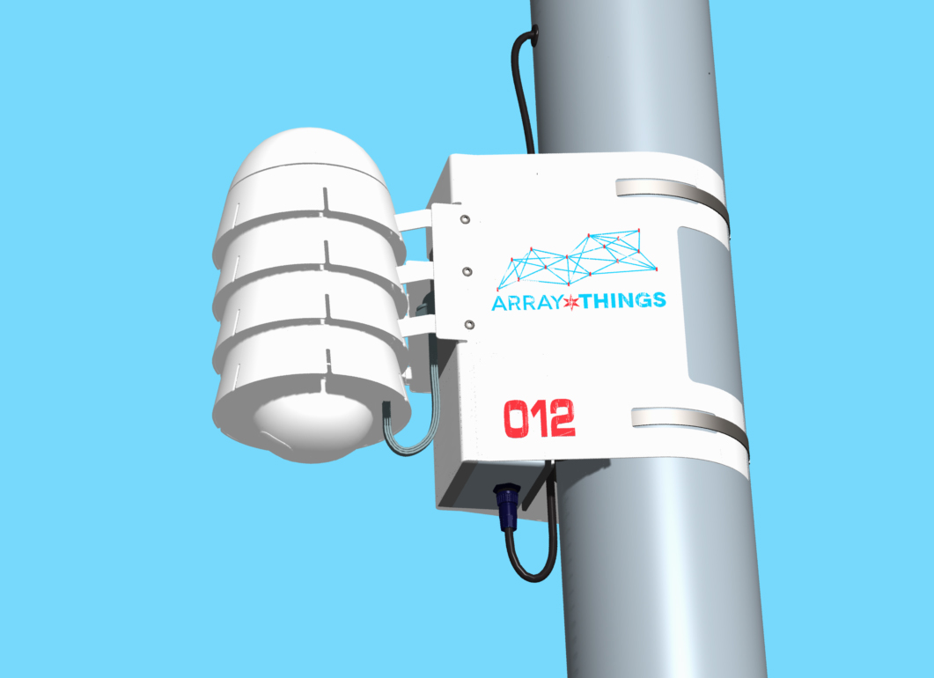
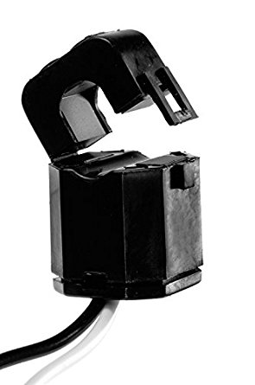
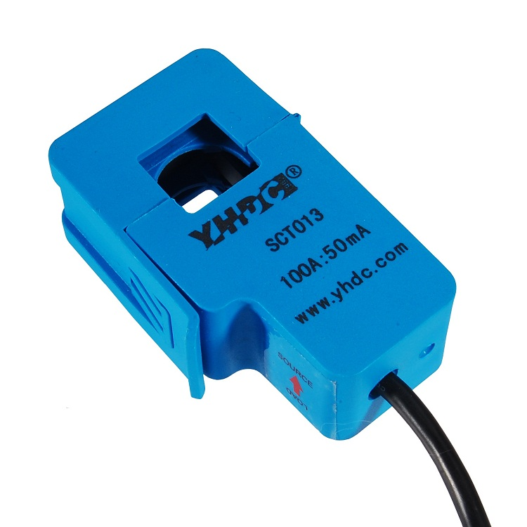
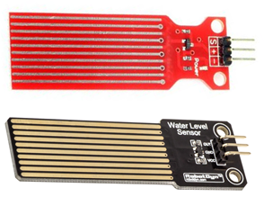
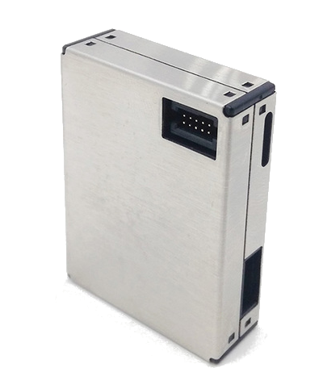
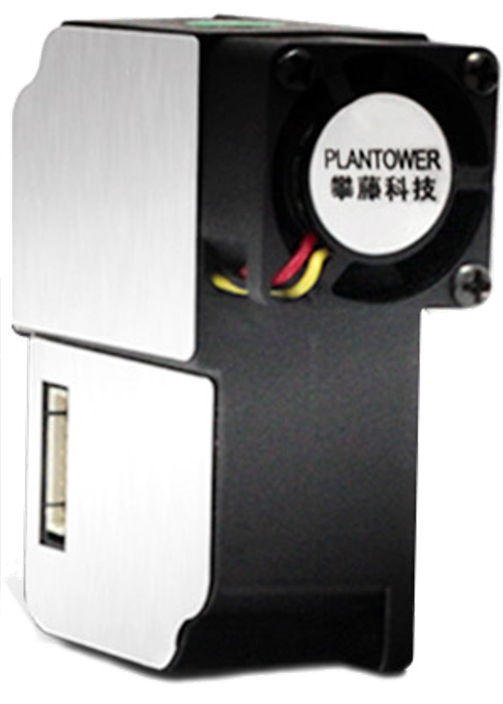
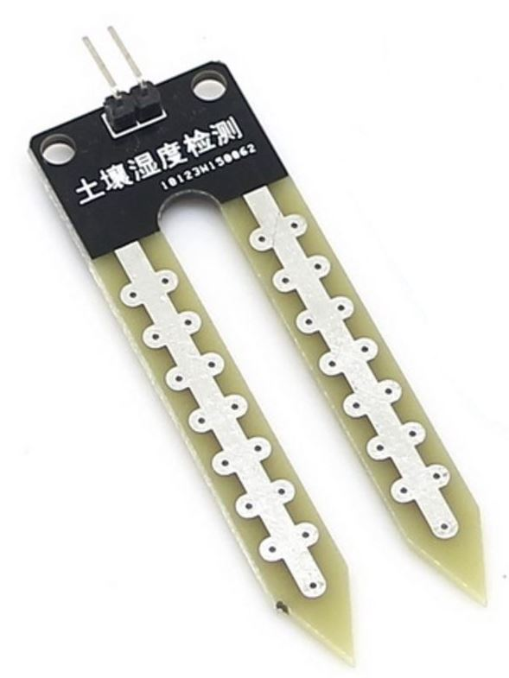
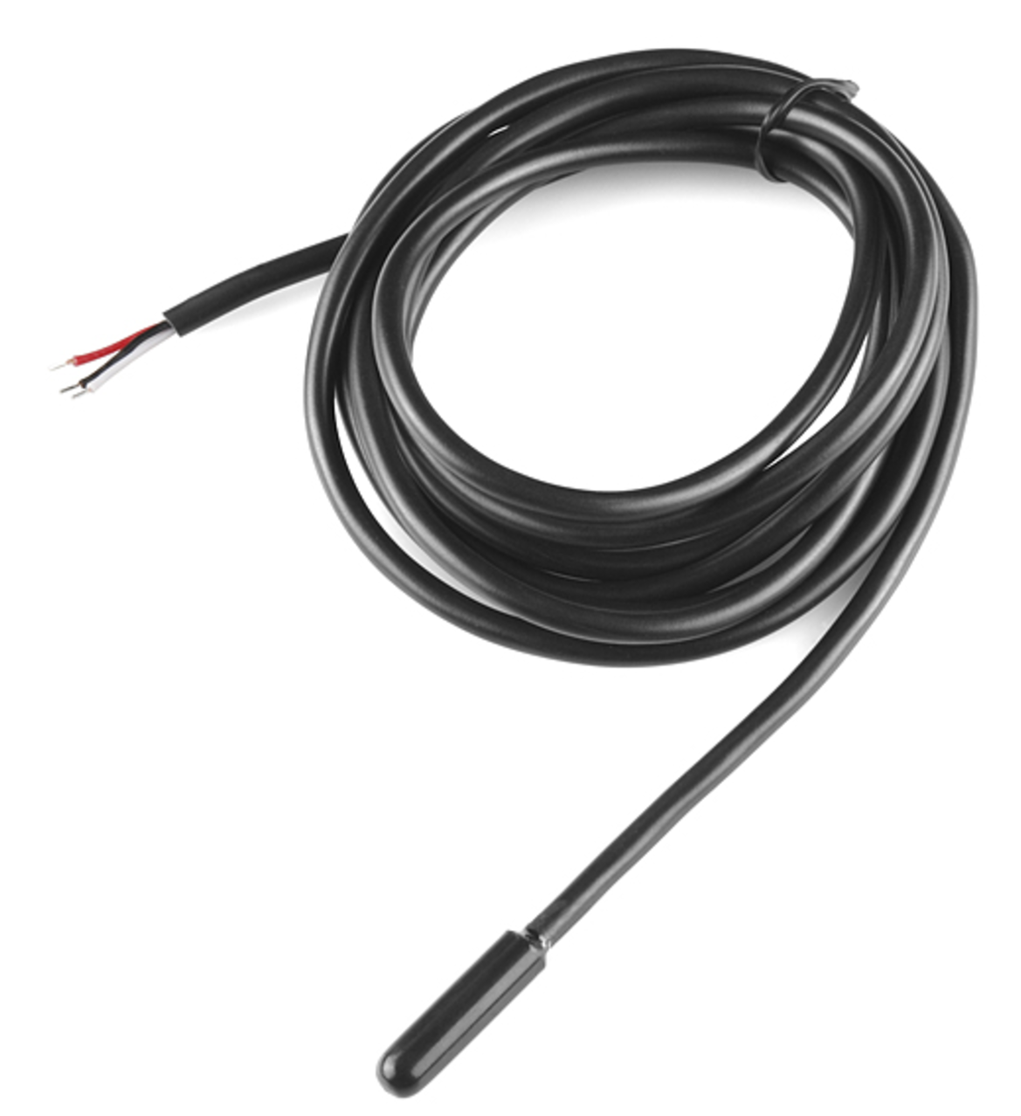
Approach
HARDWARE MODULES
https://static1.squarespace.com/static/5512f522e4b06a6b8efa5c17/55141534e4b09de0ff5f5c51/568e91fc0e4c1178cb9d0a76/1452184323680/?format=1500w
SENSORS

Slide 4
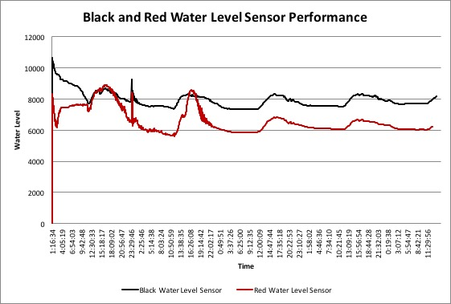
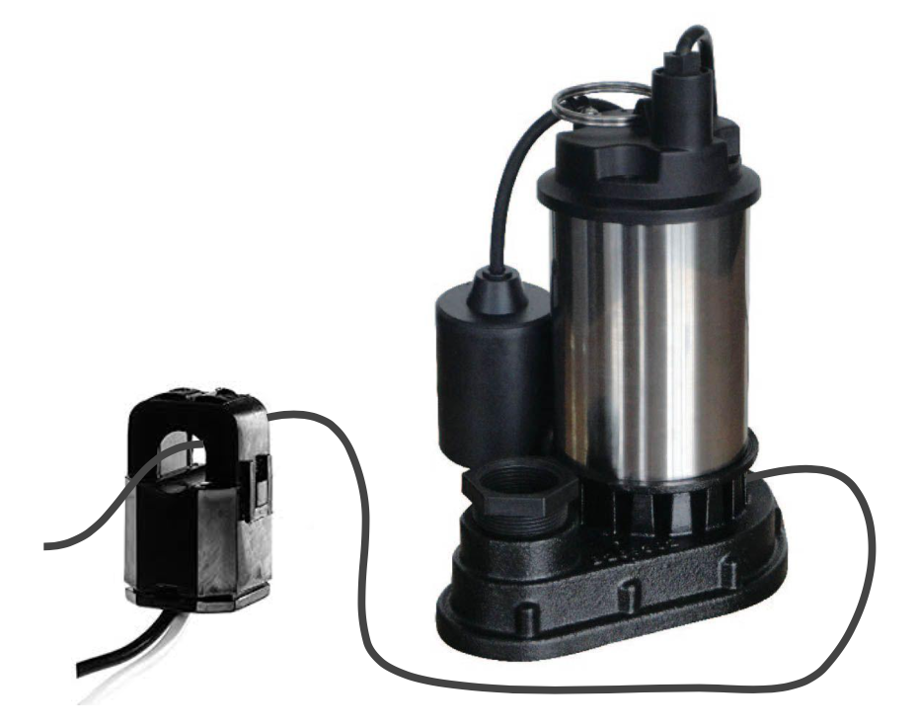
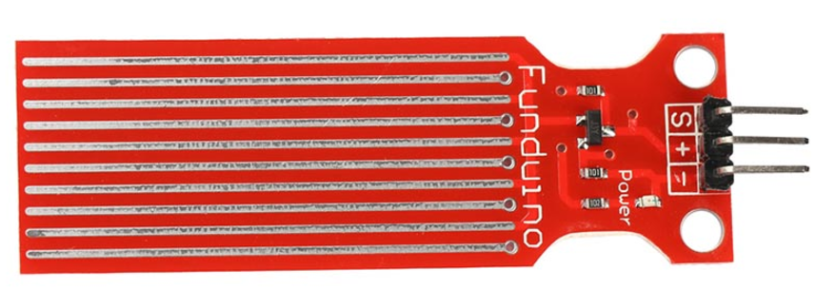
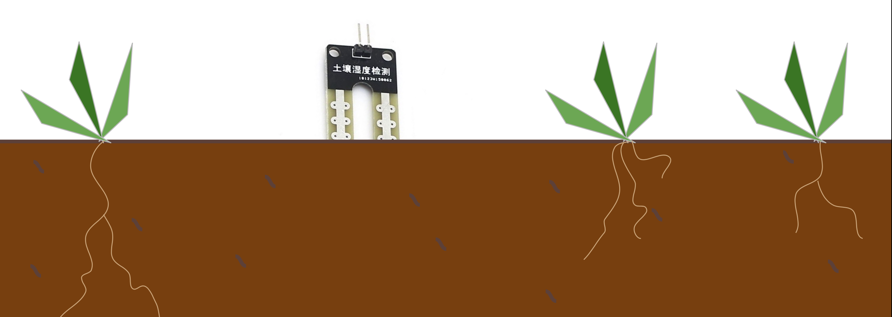
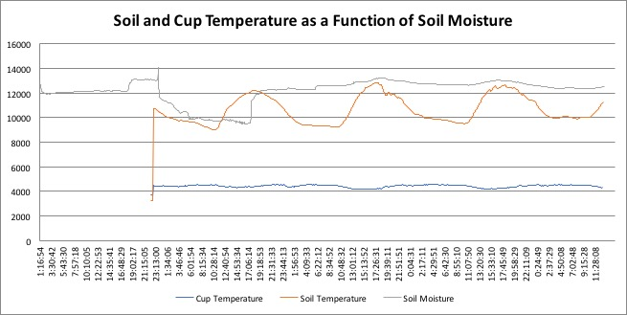
Inexpensive, low power, small sensors are effective with Photon and Electron boards and increase modularity.

Slide 5
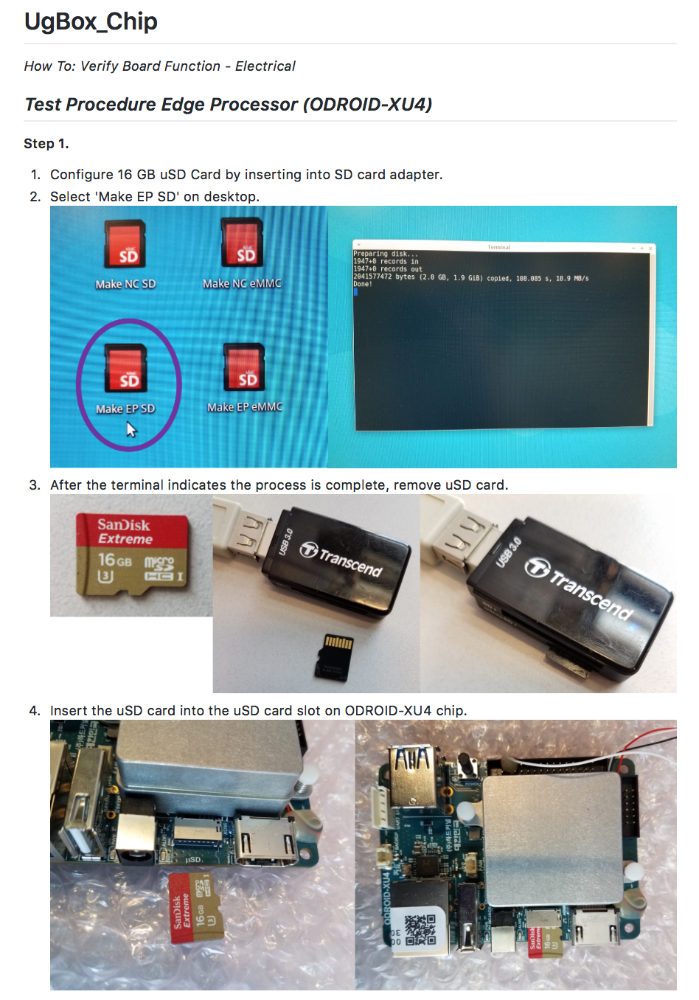
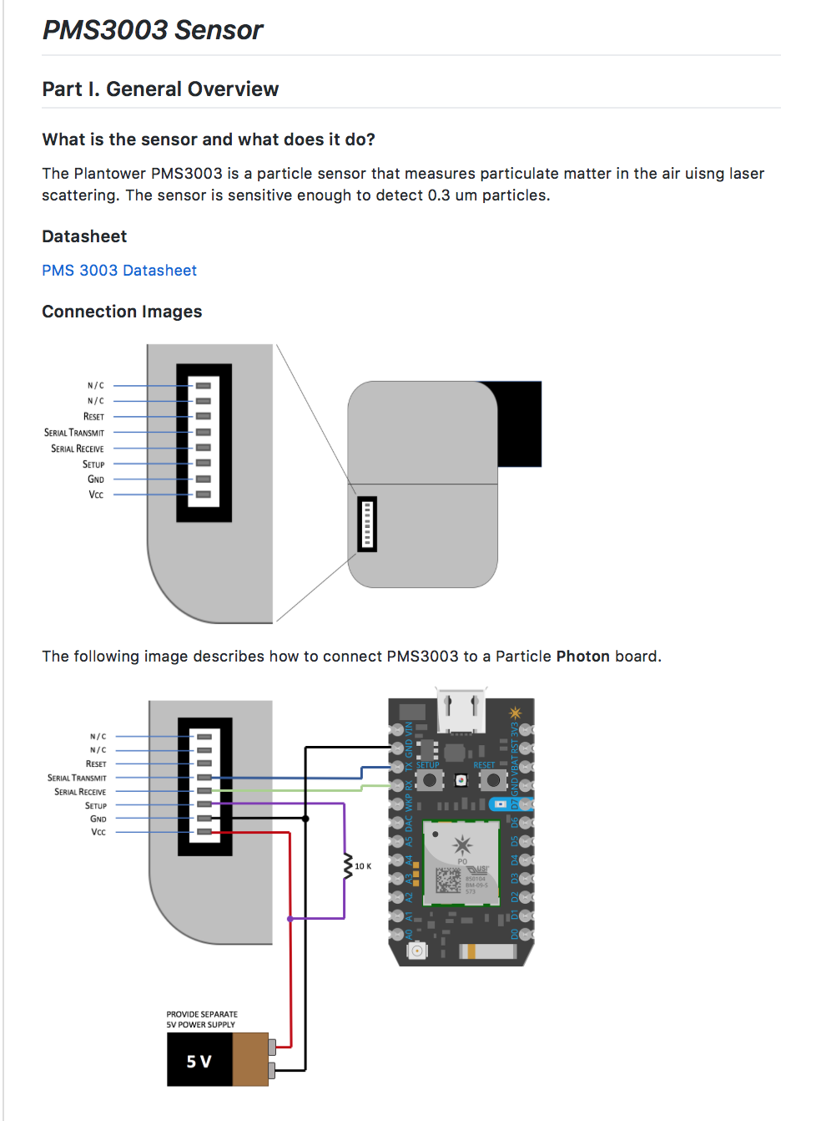
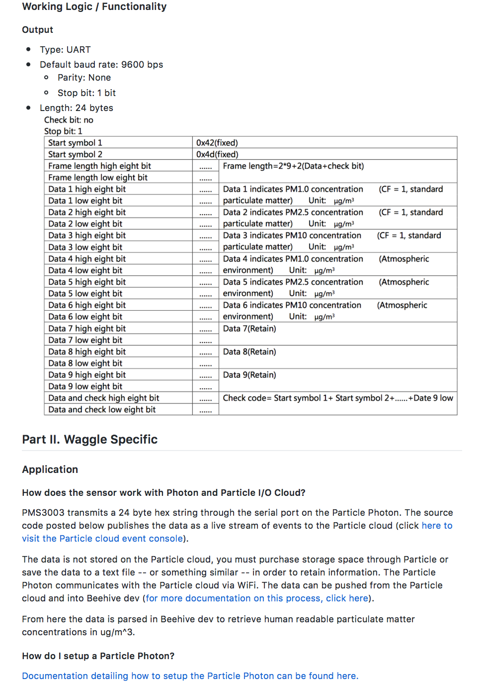
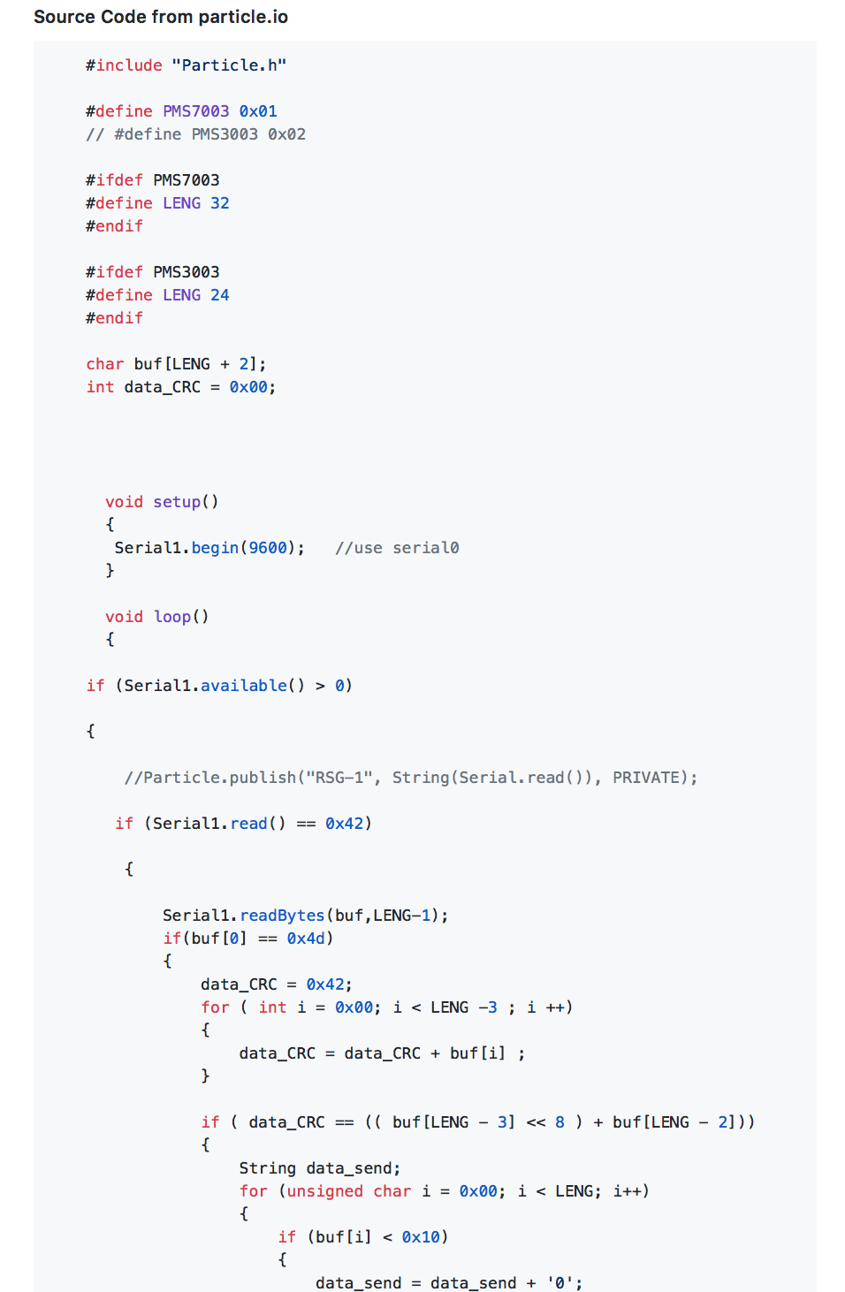
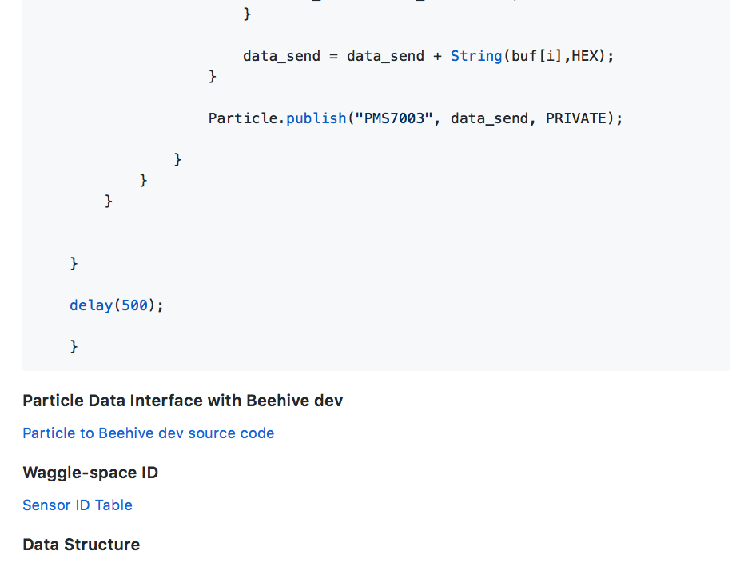
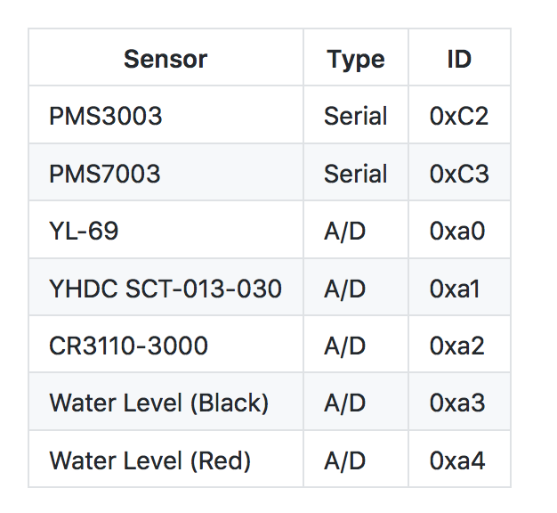
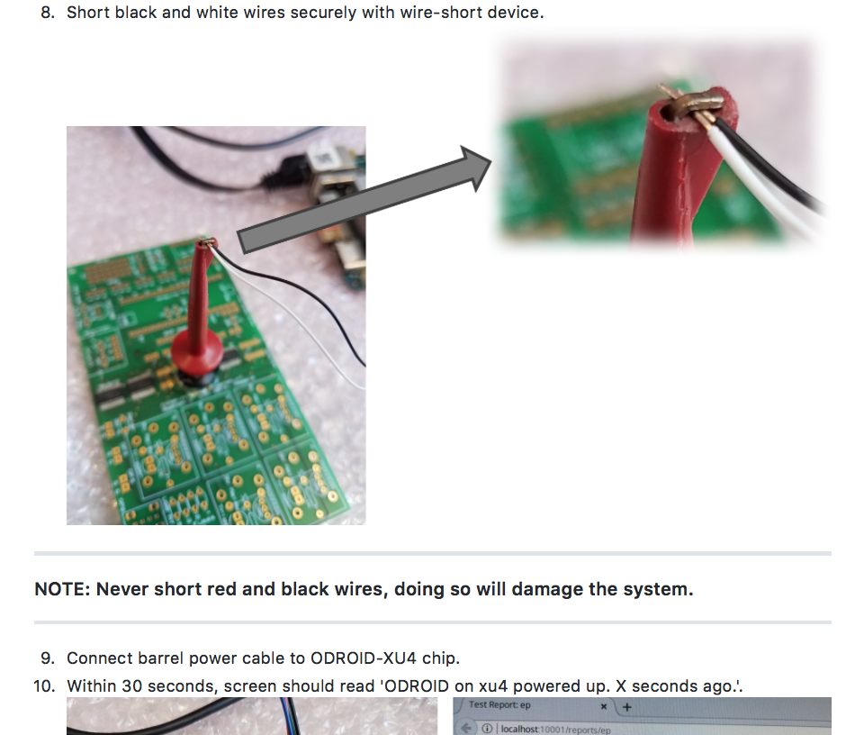
Building out the platform for plugin creation enables open source collaboration.
Notes:
Now there’s a guy who is building ugly boxes to

Slide 6
Future Direction
Sensor
Waggle MetSense
1
Sensor
Photon
Electron
2
Raw Data
Particle Cloud
Raw Data
Push Data Plugin
Beehive Dev
Python Plugin – Push Data
Beehive Dev
3

